Slide 1
DSA
Lecture#16

Slide 2
Heap
It is a non-linear data structure.
It must be an almost complete binary tree.
Heap is used in sorting algorithm known as heap sort.
Types of heap:
Max heap
Min Heap

Slide 3
Max heap (By default- heap)
When we say heap, it means we are talking about max heap.
The value at each node N is greater than or equal to the value at each children of node N.

Slide 4

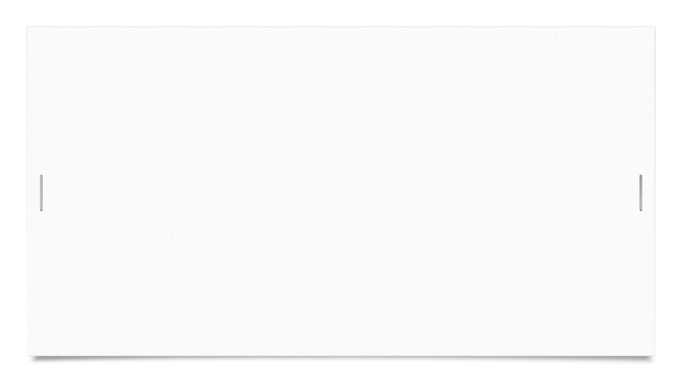
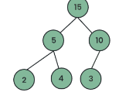

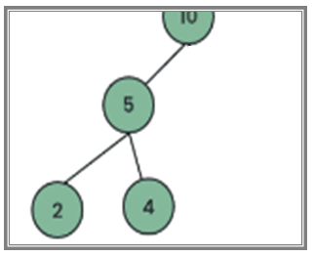
Example
Identify the heap:

Slide 5
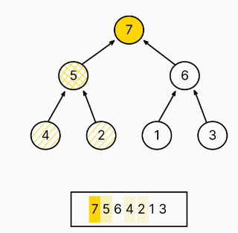
Representation of Heap
Instead of making nodes, linear array (list) is used to maintain the heap in memory.

Slide 6
Cont…
A heap is called a nonlinear data structure because its logical organization is hierarchical, rather than sequential.
This classification is based on the relationships between elements, not on their physical storage in memory.

Slide 7
Index of node
Formula:
Index of left child node= 2* index +1
Index of right child node=2*index+2
Index of parent node=(index-1)/2

Slide 8

Heap sort
Suppose we have an unsorted array:
Step-A: Create a max heap
Step-B: Delete the element from the heap from root and sort the deleted items in an array.

Slide 9
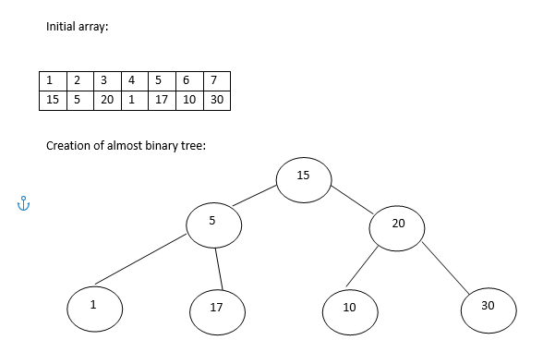
Creation of max heap
We start the first index as 1 instead of 0.

Slide 10
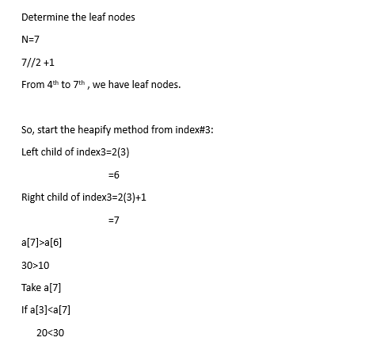
Cont…

Slide 11
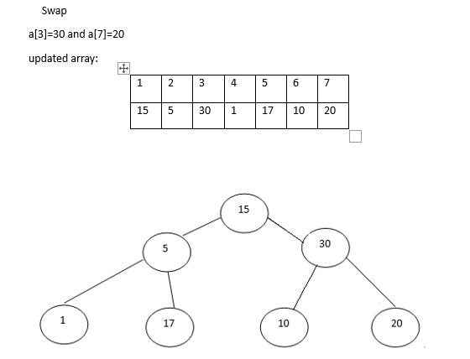
Cont…

Slide 12
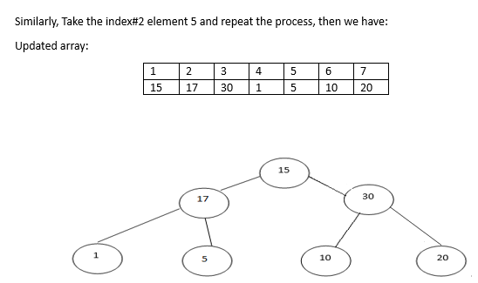
Cont…

Slide 13
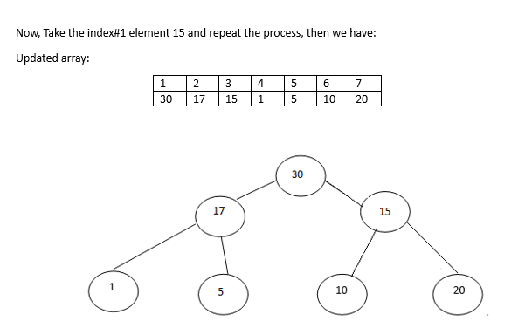
Cont…

Slide 14
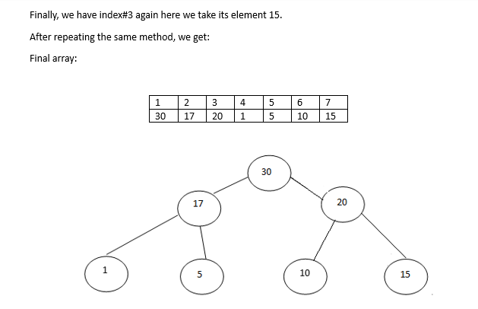
Cont…

Slide 15
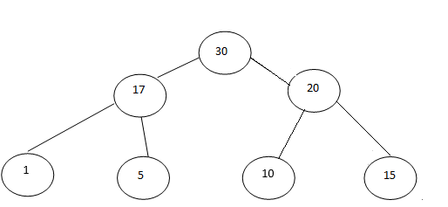

Deletion of max heap
Max heap:

Slide 16
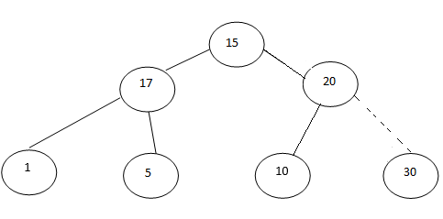

Cont…
After swapping 30 with 15:

Slide 17
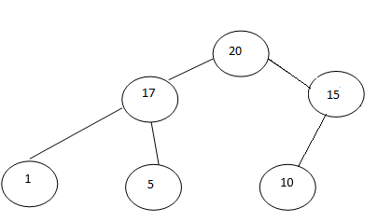

Cont…
Make it max heap:

Slide 18
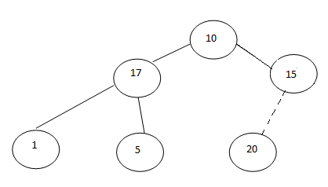

Cont…
After swapping 20 with 10:

Slide 19
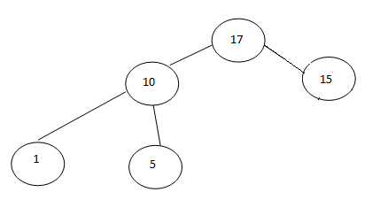

Cont…
Make it max heap:

Slide 20
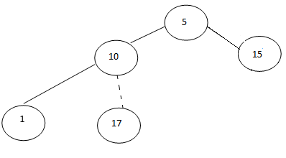

Cont…
After swapping 17 with 5:

Slide 21
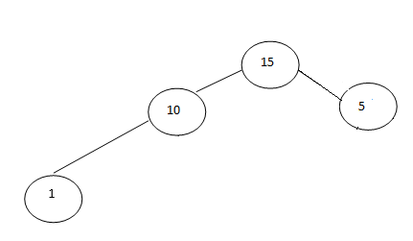

Cont…
Make it max heap:

Slide 22
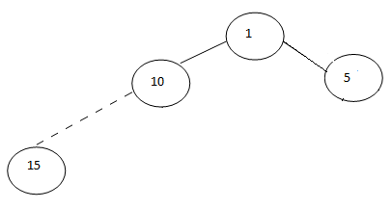

Cont…
After swapping 15 with 1:

Slide 23
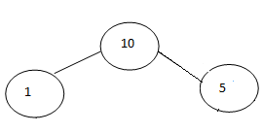

Cont…
Make it max heap:

Slide 24
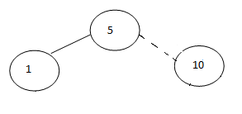

Cont…
After swapping 10 and 5:

Slide 25
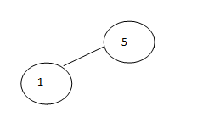
Cont…
It is already a max heap:

Slide 26
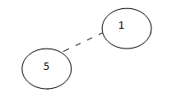

Cont…
After swapping 5 and 1:

Slide 27
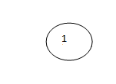

Cont…
Delete the element from the root

Slide 28
Cont…
Final sorted array:

